Slide 1
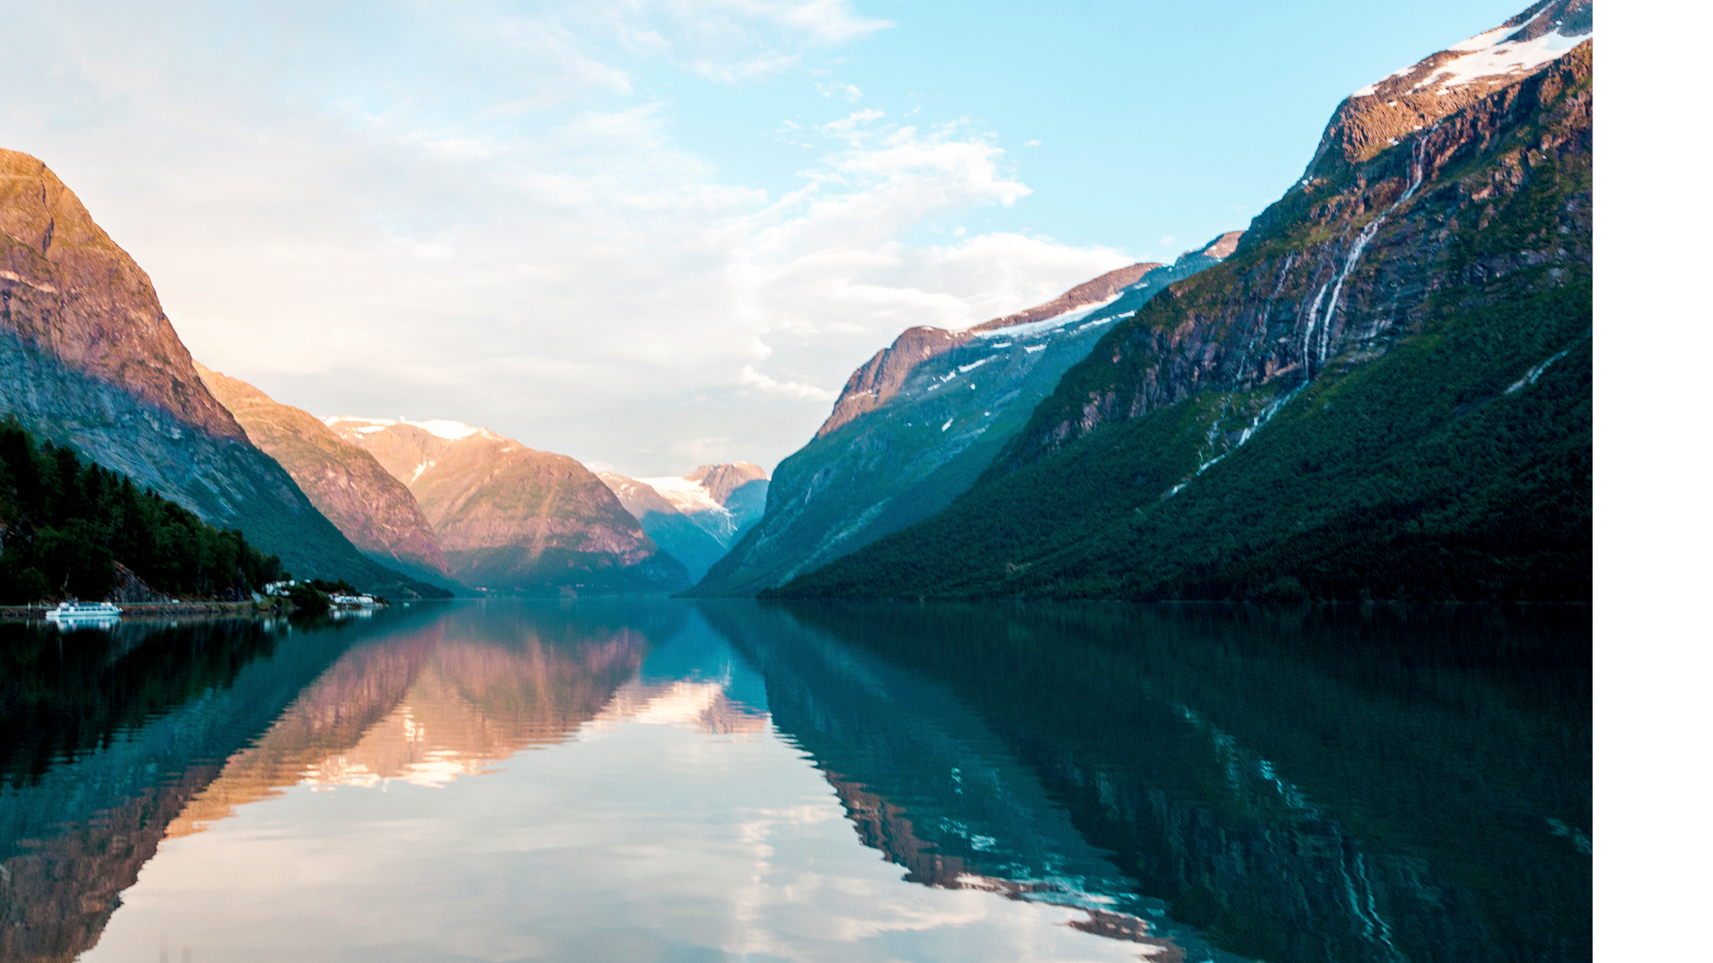
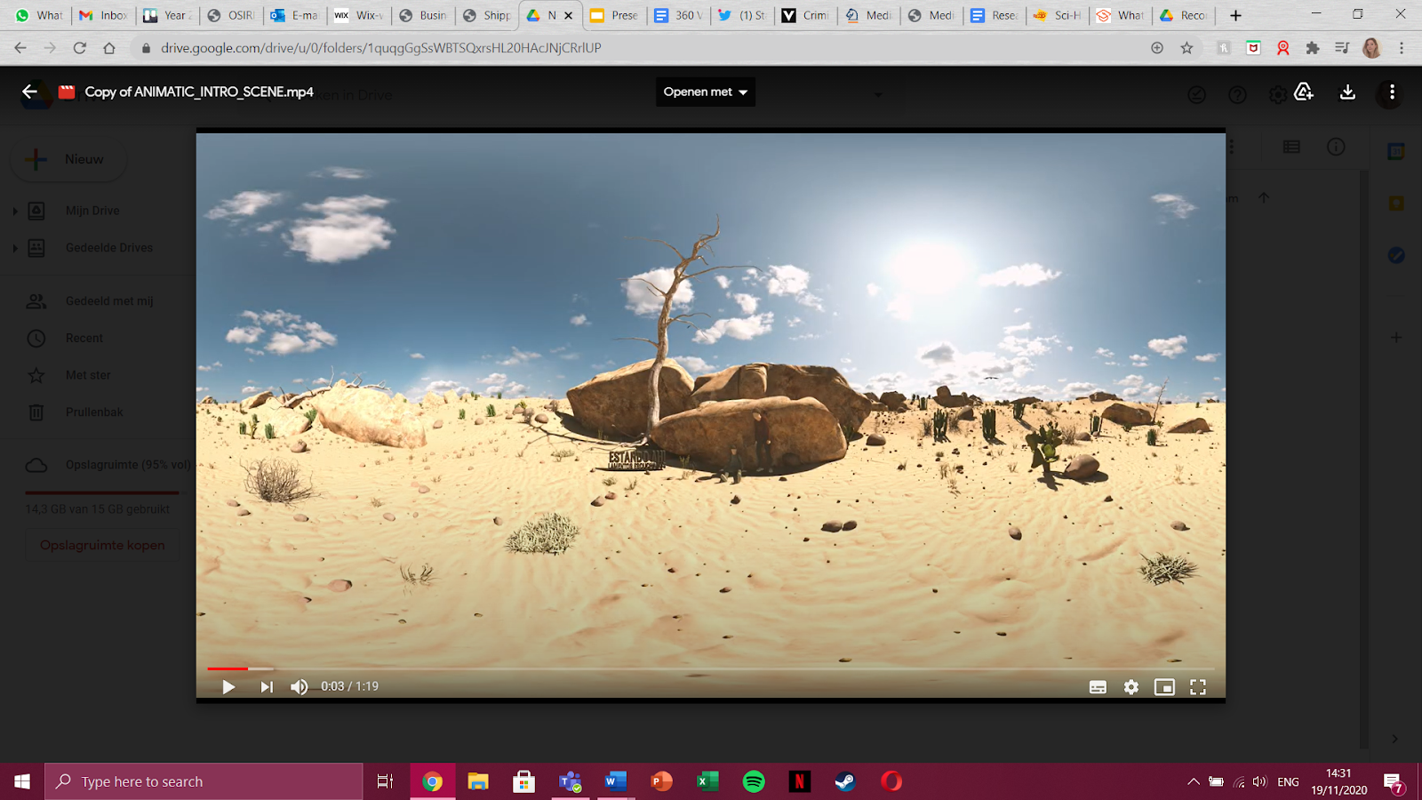
Being There Volumetric Characters & 360 storyboards
Final Presentation BUAS

Slide 2
Introduction
First Virtual Reality Museum for Migrant Women: creating engagement and innovative participatory design approaches through Virtual Reality Spaces.

Slide 3
TABLE OF CONTENTS
01
02
03
Introduction VR, Volumetric Capture & 360 videos
The added value
The volumetric characters
04
05
360 videos
Conclusions & recommendations

Slide 4
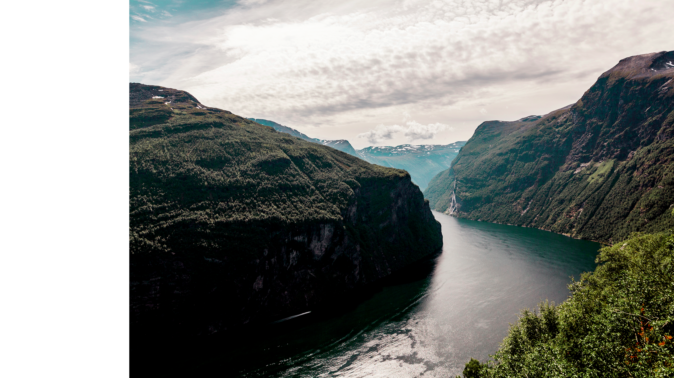
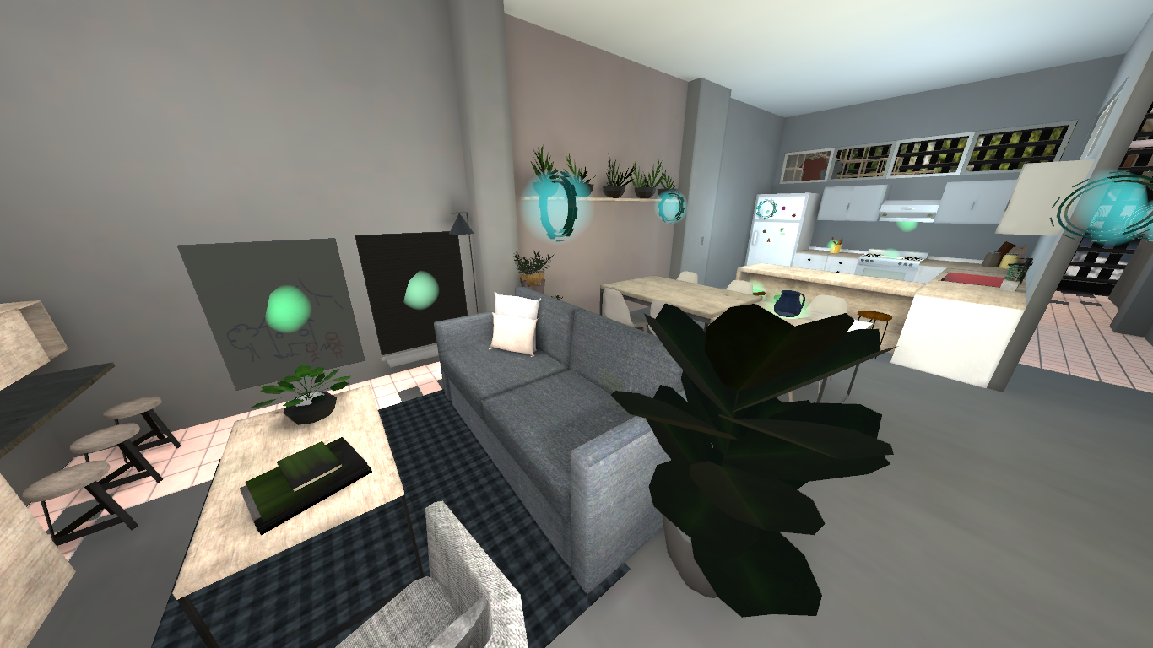
01
Introduction VR, Volumetric Capture & 360 videos

Slide 5
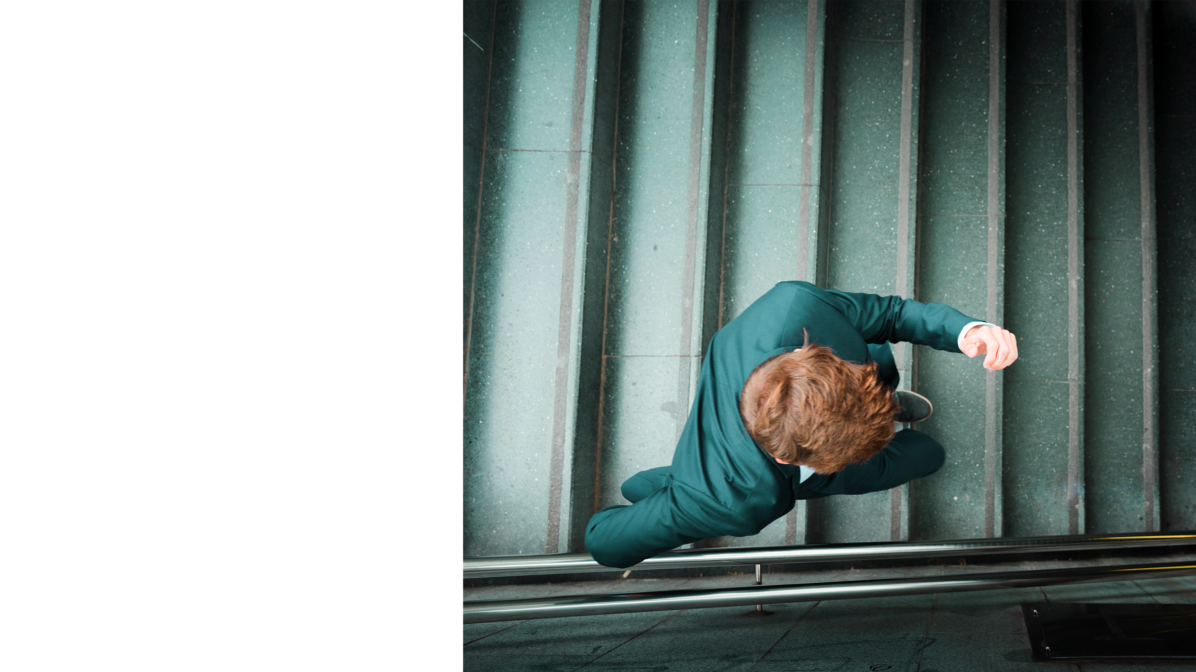
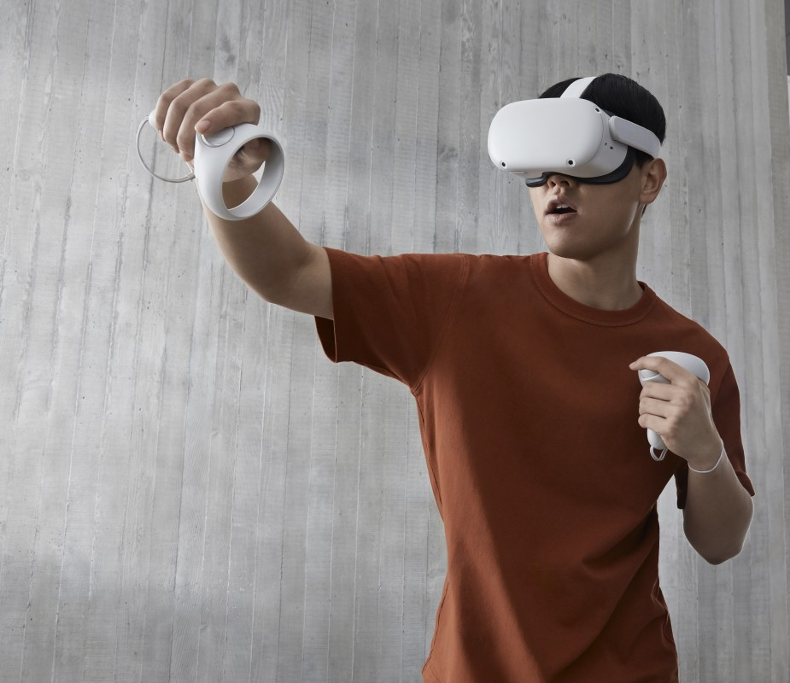
Virtual Reality
Simulated experience
Immersion
VR museum for project “Being There”

Slide 6
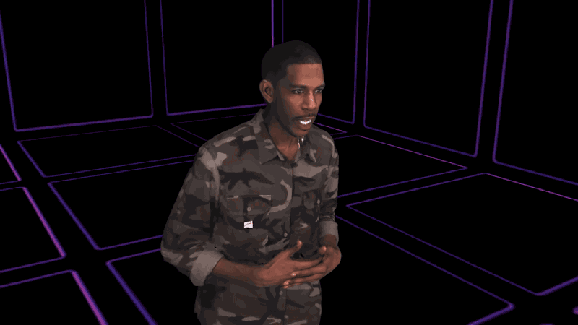
Volumetric Capture
New technology
Creating a 3d model of a real person

Slide 7
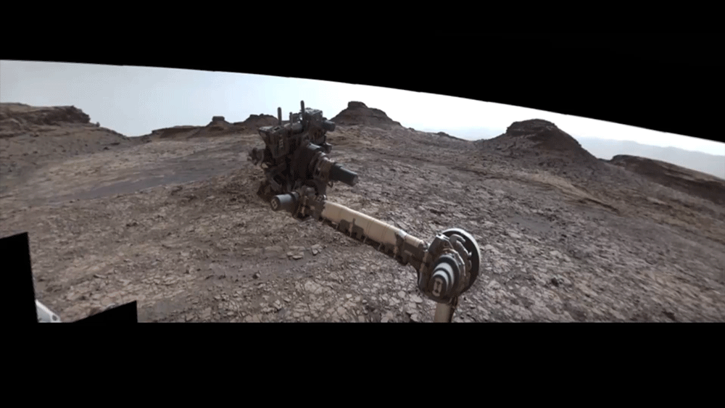
360 videos
All around video
360 camera
Showing reality

Slide 8
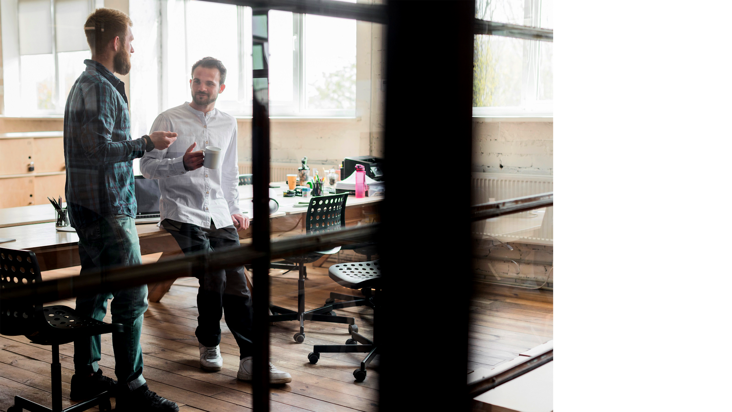
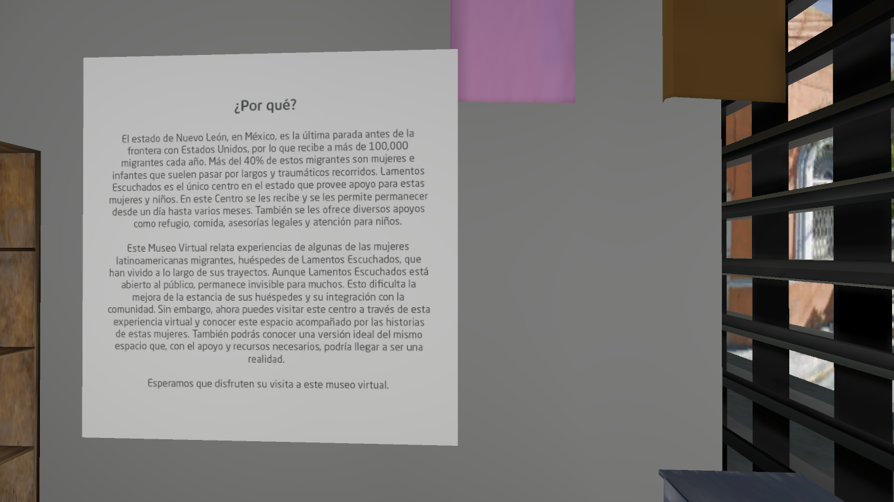
02
The added value

Slide 9
WHY 360 VIDEOS?
CREATES EMPATHY
ESTABLISHING SPACE
SHOW THE REALITY
Seeing a real human going through something will create more empathy than only showing animations.
With a 360 video we’ll be able to show the real space, giving more meaning to the virtual space. Making users realise that it’s a real building that needs help.
With a 360 video we’ll be able to show the reality and the real world. Something that hasn’t been shown in the VR museum yet.

Slide 10
WHY NOT JUST 360 VIDEOS?
USER INTERACTIONS
CREATES EMPATHY
CENTER POINT
ESTABLISHES SPACE AND PERSPECTIVE
Another added benefit of volumetric capture, is that the user can interact with certain objects, something not possible in 360 videos.
Design aspects aside, adding all these together help to immerse and create empathy, a big goal of the project.
In 360 videos, the user cannot see (close to) the center point, as it would simply vanish. This is possible in volumetric capture, however.
With volumetric capture, one can establish these two aspects effectively, coming as close to reality as possible.

Slide 11
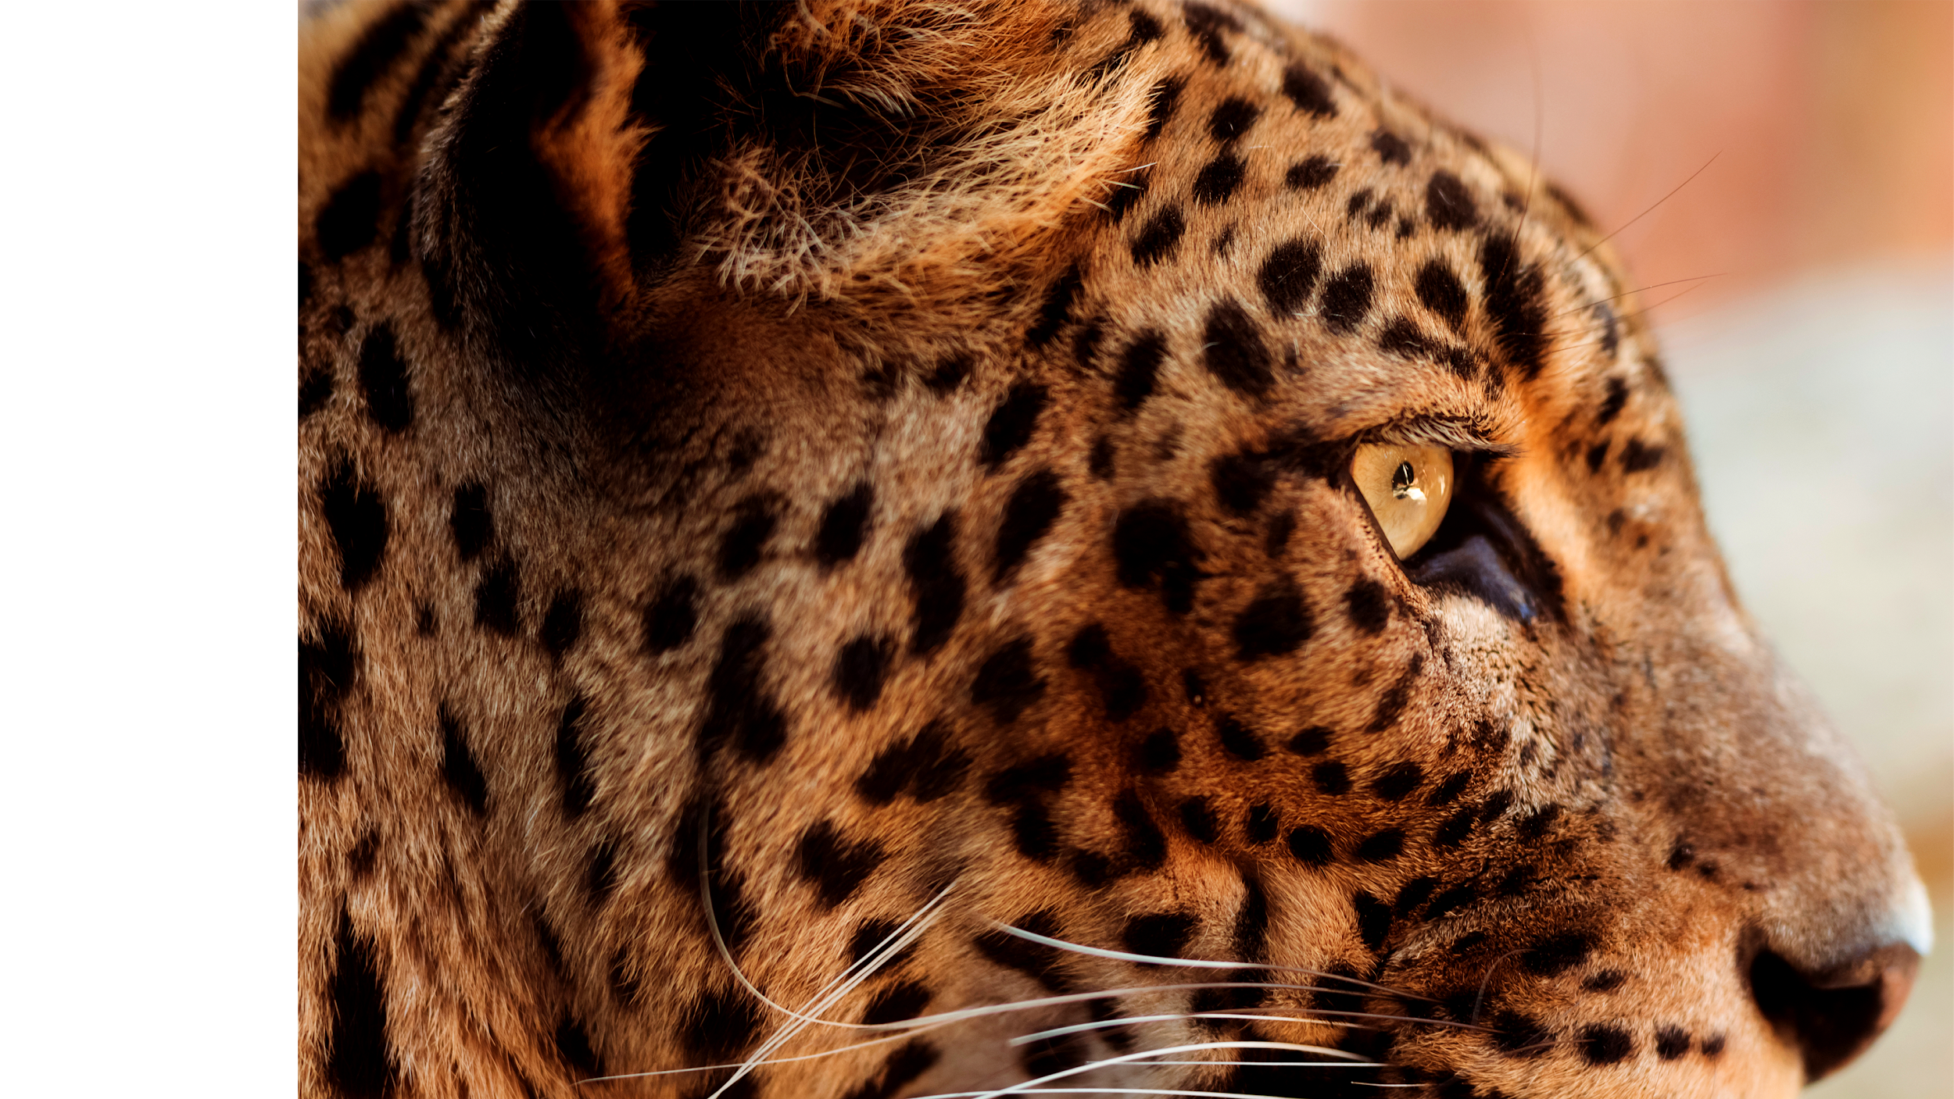
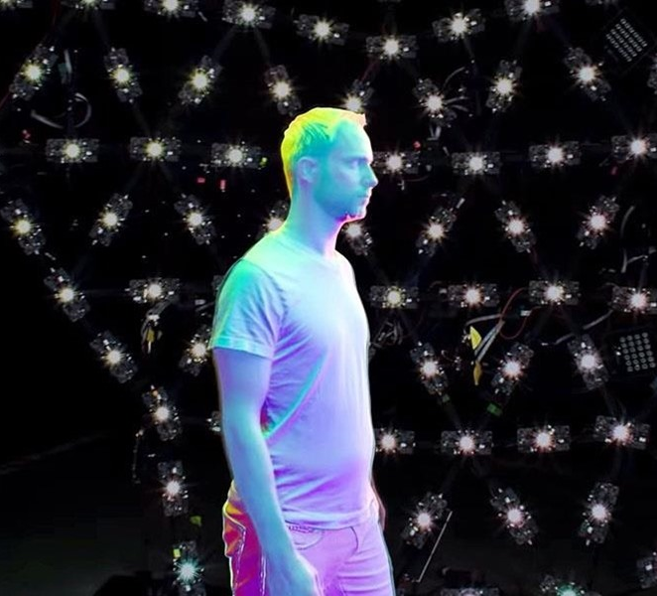
03
The Volumetric Characters

Slide 12
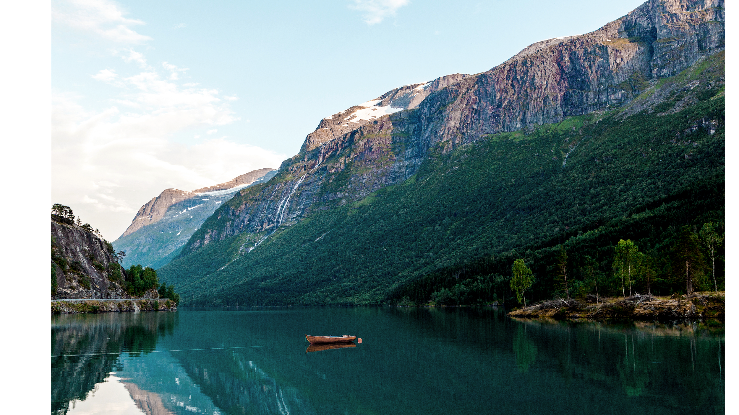
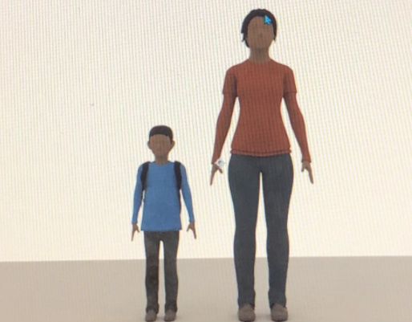
Character 1 The Woman
Character 2 The Child
- Brave, caring, selfless, confident, active
- Dark coloured second-hand clothes, wears a rosary around her neck
- Straight and middle short hair, natural make-up, minimal eyeliner
Innocent, shy, confused (new situations)
- Wears a blue T-shirt, dirty shoes
- Dark brown straight hair. Minimal eyeliner
Why this character?
Why this character?

Slide 13
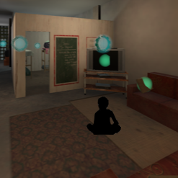
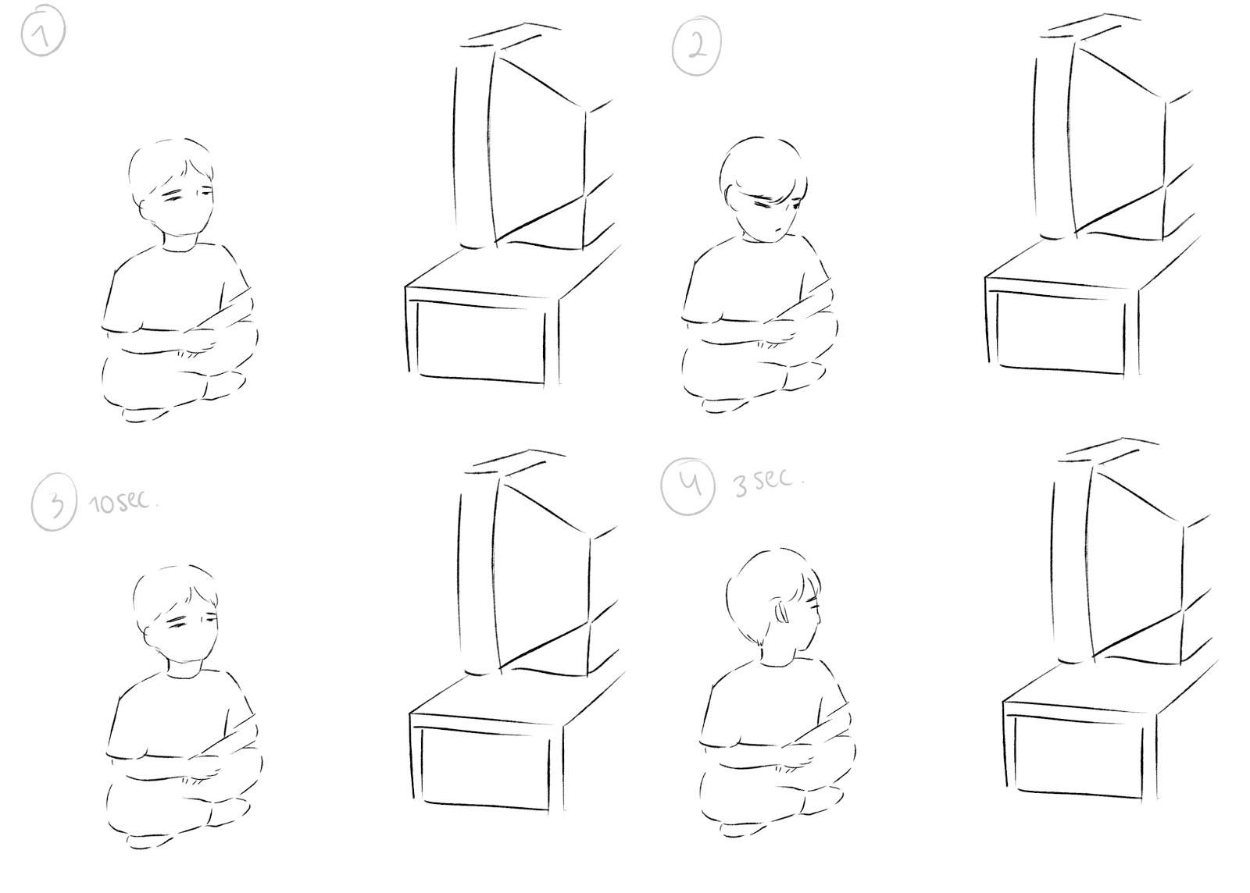
Volumetric Capture
INTERACTION 1 CURRENT SPACE
Place:
Living room
Lighting:
Normal incandescent light 3500K and television fill light
Character and action:
The child - looks shy and uncomfortable
Time:
Entire action takes 10 seconds, with 3 seconds for him looking to his left (at the door)
Sound:
Television / white noise on a low volume / far away noise of the street

Slide 14
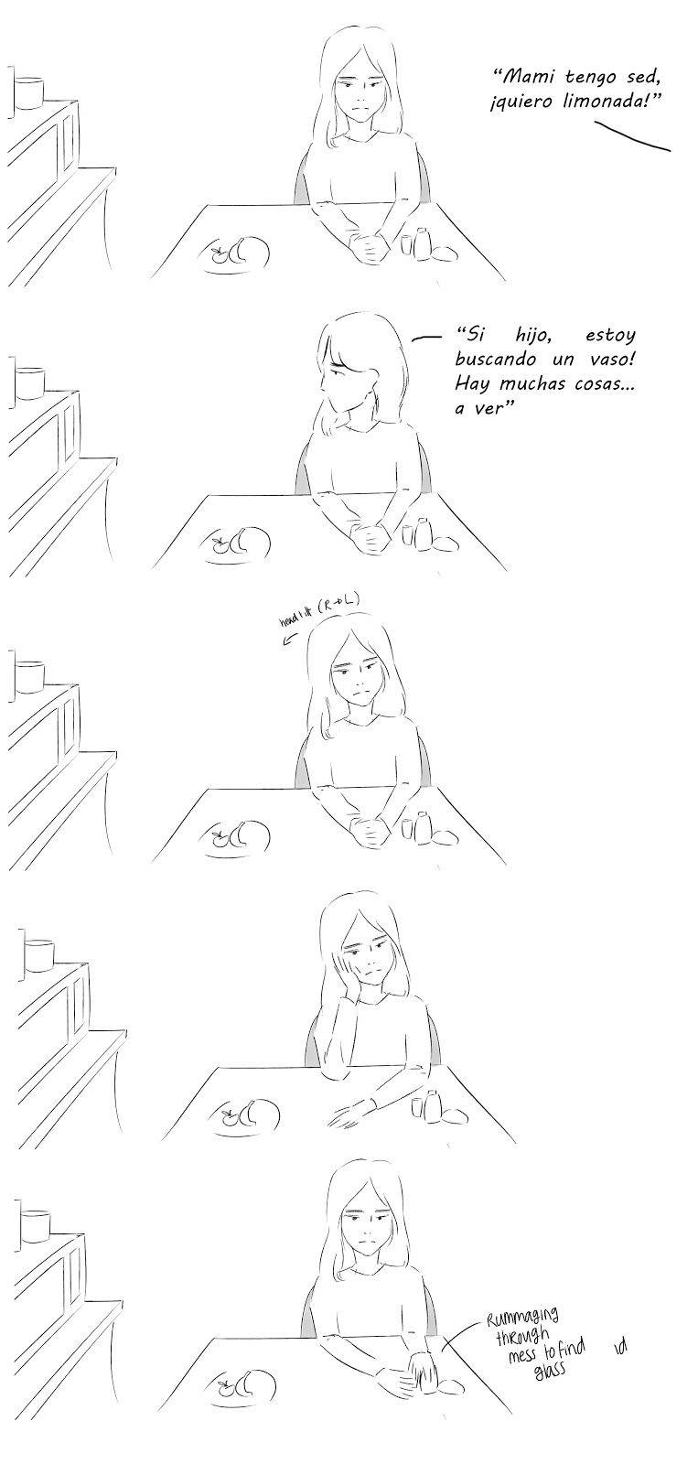
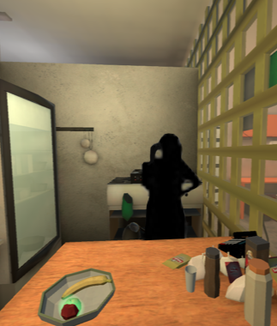
Volumetric Capture
INTERACTION 2 CURRENT SPACE
Place:
Kitchen
Lighting:
Neutral Light 5,000K
Character and action:
Character will look at the kitchen counters, showing the struggle of finding an item in the kitchen.
Time:
15 seconds of total movements, to be looped
Sound:
Kitchen electro-domestic noise / bits and pieces of barely audible dialogue /
far away noise of the street / soft (small) footsteps

Slide 15
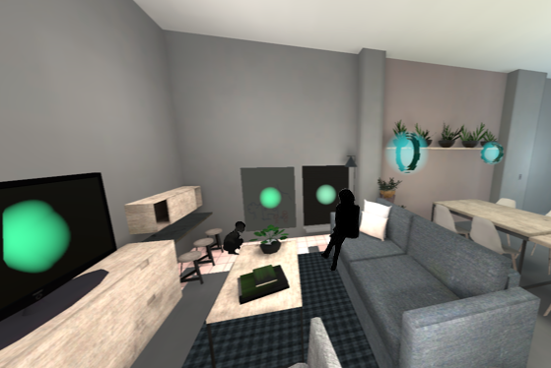
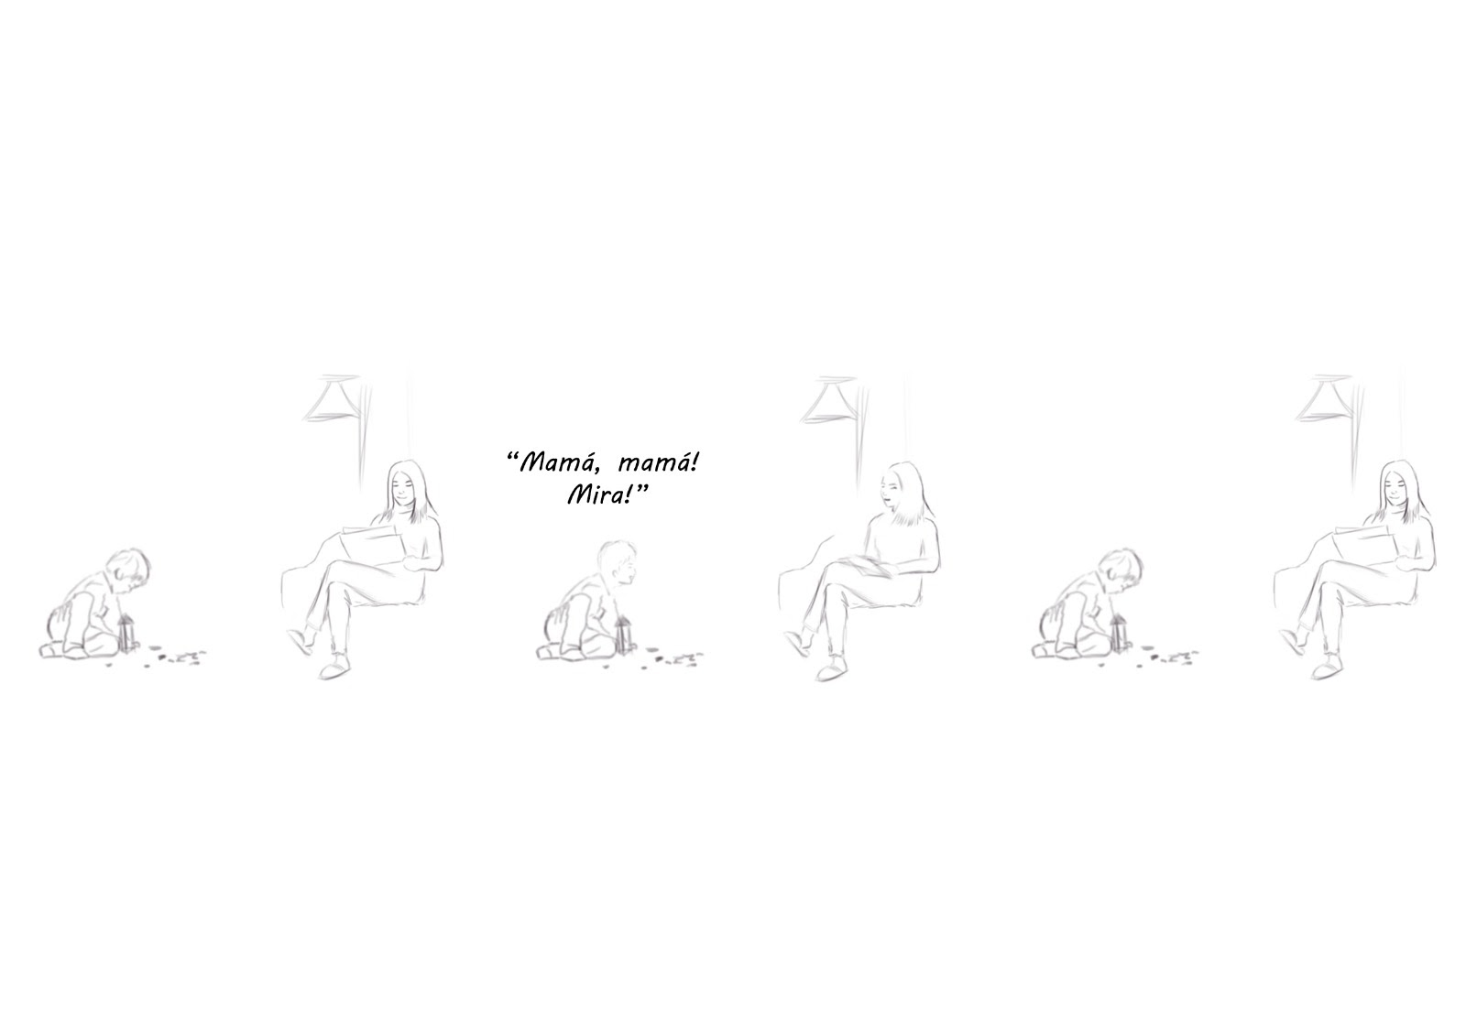
Volumetric Capture
INTERACTION 3 IDEAL SPACE
Place:
Living Room / Kid’s corner
Lighting:
Normal incandescent light 3500K
Character and action:
Both characters, the woman is reading while the child is playing with a toy.
Time:
10 seconds total with the child playing, the woman reading,
then, woman lowering newspaper.
Sound:
The movement of the newspaper / small dialogue / white noise

Slide 16
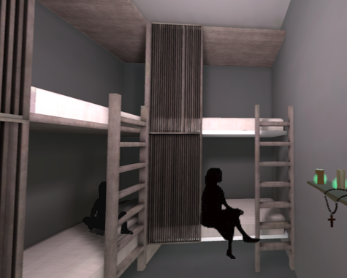
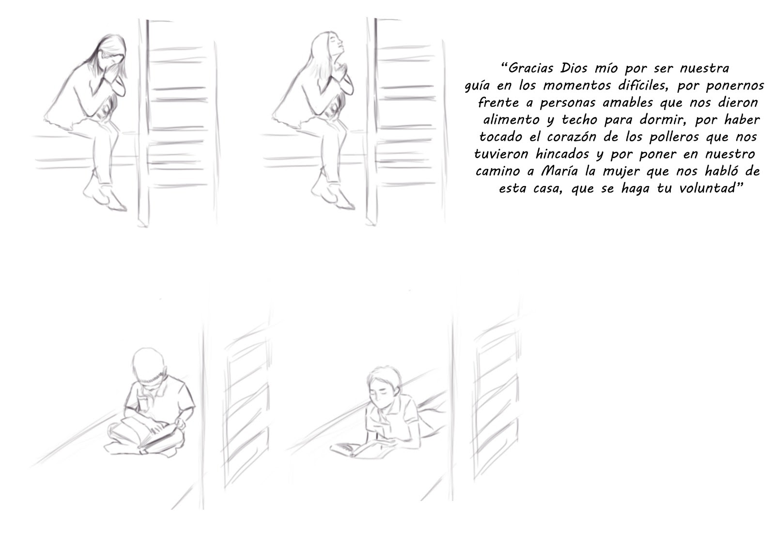
Volumetric Capture
INTERACTION 4 IDEAL SPACE
Place:
Bedroom
Lighting:
Dim light 2,000K orange-y tone
Character and action:
The woman is thankful because she and her son have a safe place (shelter) where they can stay. She prays, the child is reading.
Time:
45 seconds. the child is looking at a book (reading), the woman is praying.
Sound:
Child breathing and mumbling as he reads / the sound of the bed when he moves / sound of pages being turned / woman whispering (praying)
calmed, almost like a whisper

Slide 17
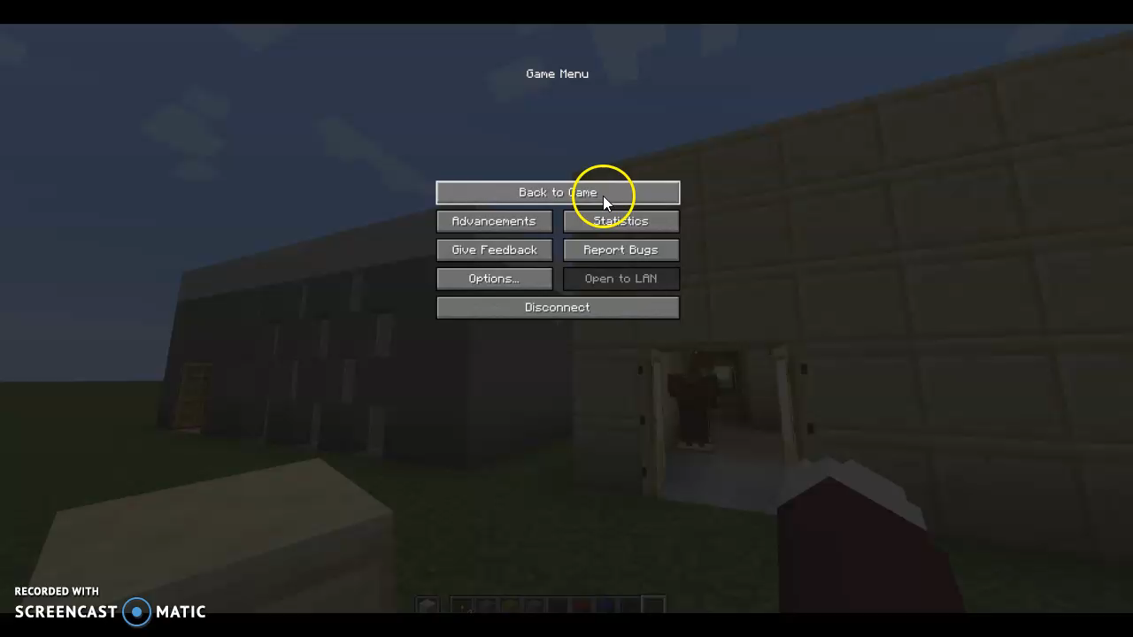
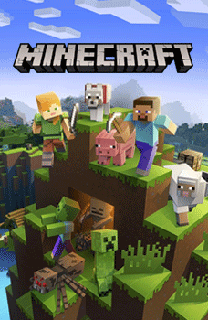
Using Minecraft to create a 360 storyboard

Slide 18
The volumetric studio
Actors
Technicalities
Measurements
Outfits & make-up
2 actors
1 Woman & 1 young boy
-2 minutes to film
- No access to all final necessary measurements
-straight hair
-clear facial features → enhance with make-up
-no green in the clothing

Slide 19
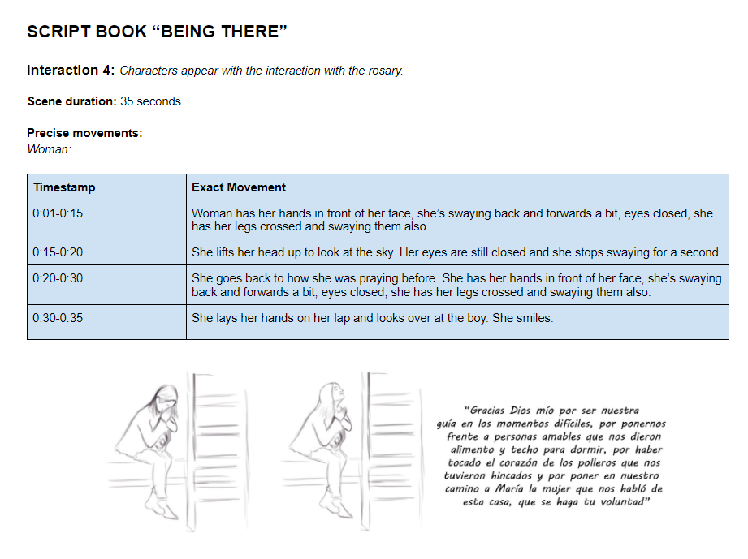
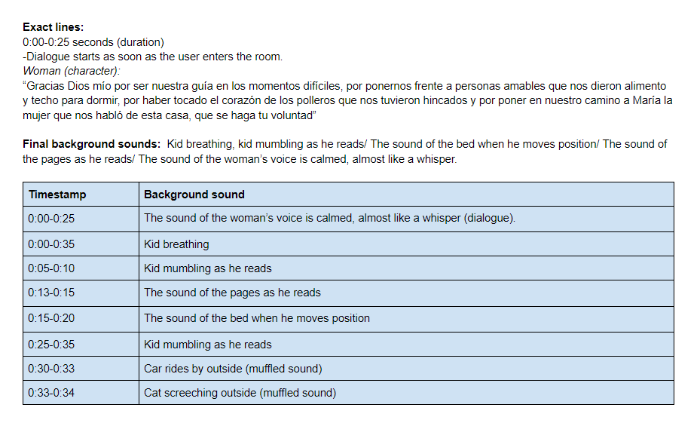
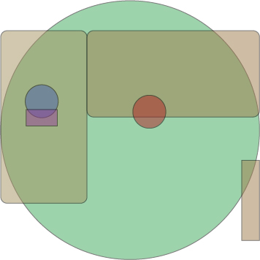
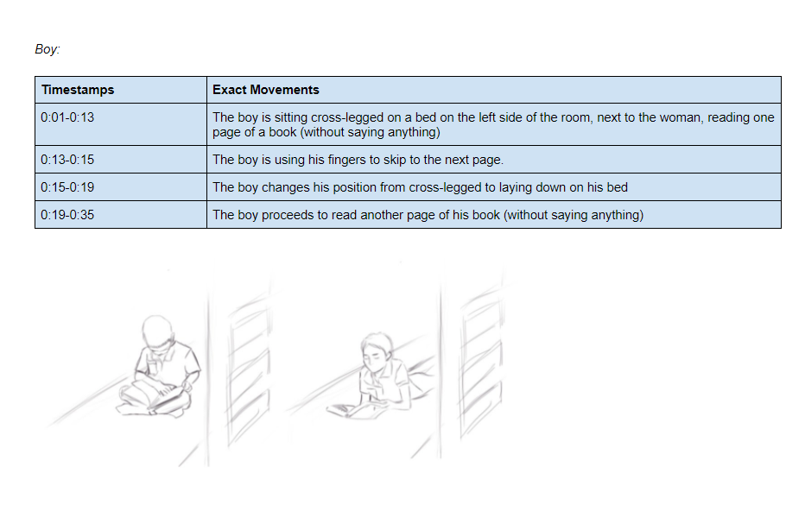
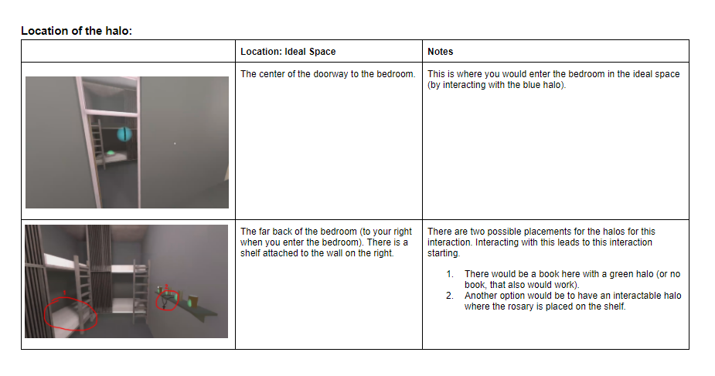
Script book Interaction 4

Slide 20
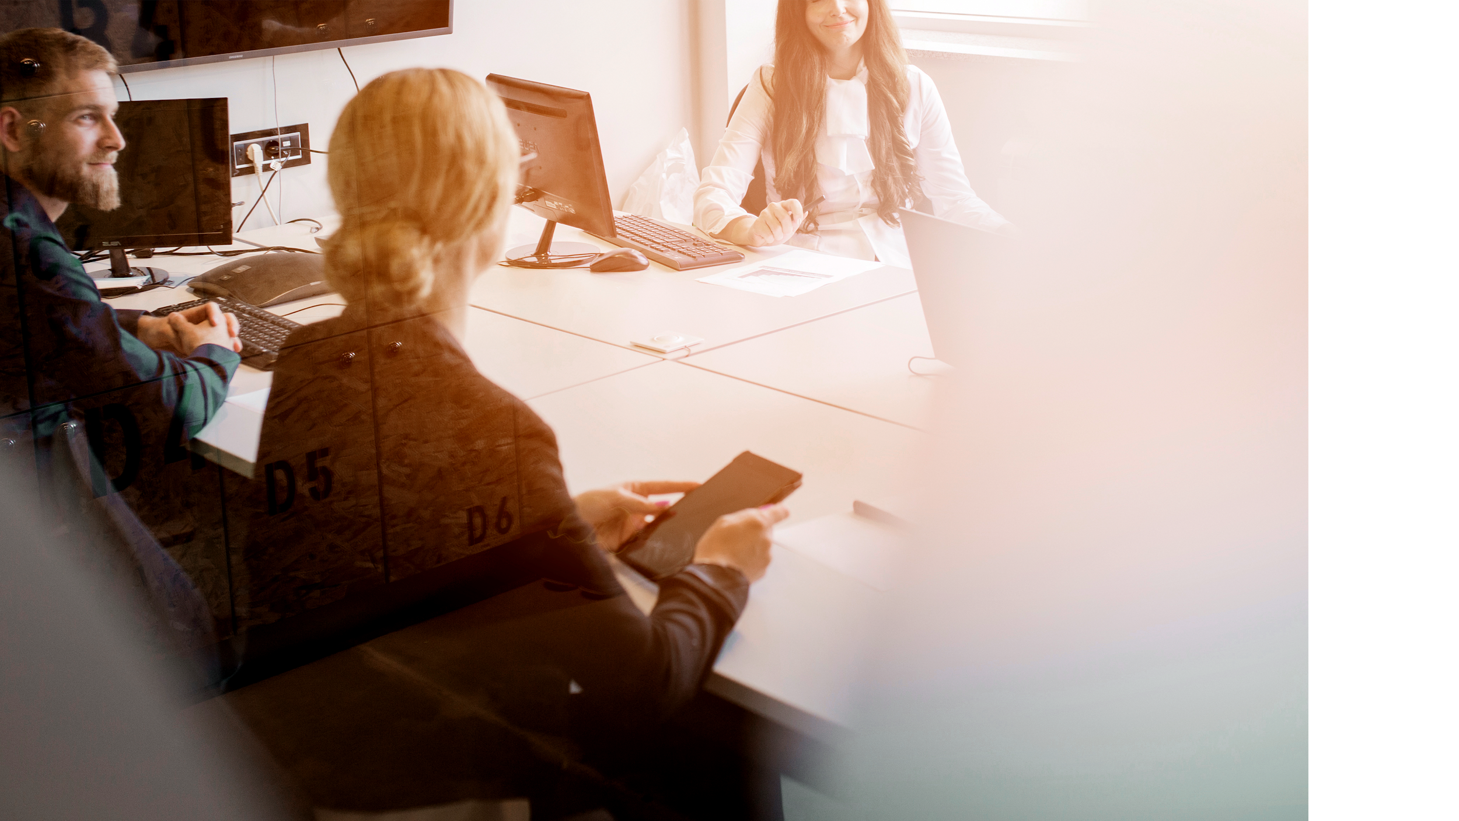
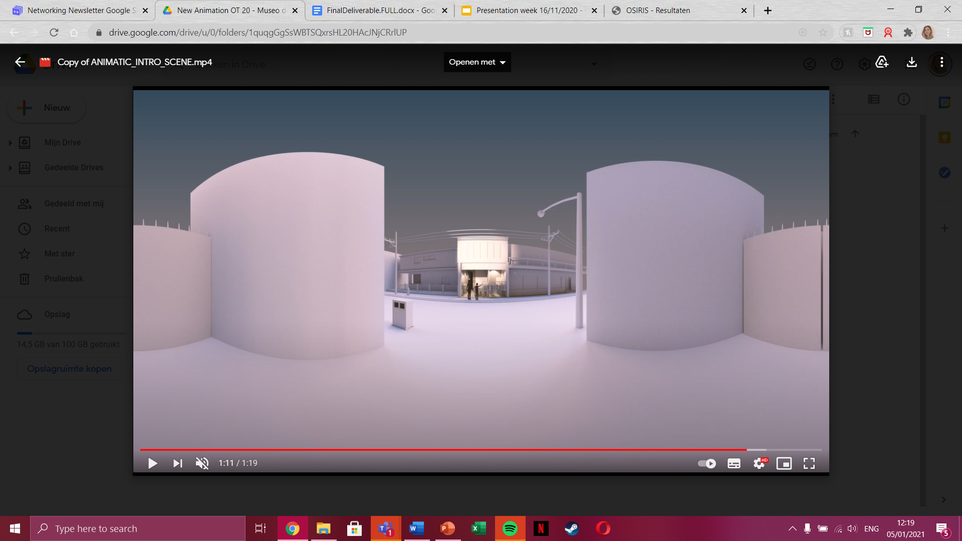
04
360 videos

Slide 21
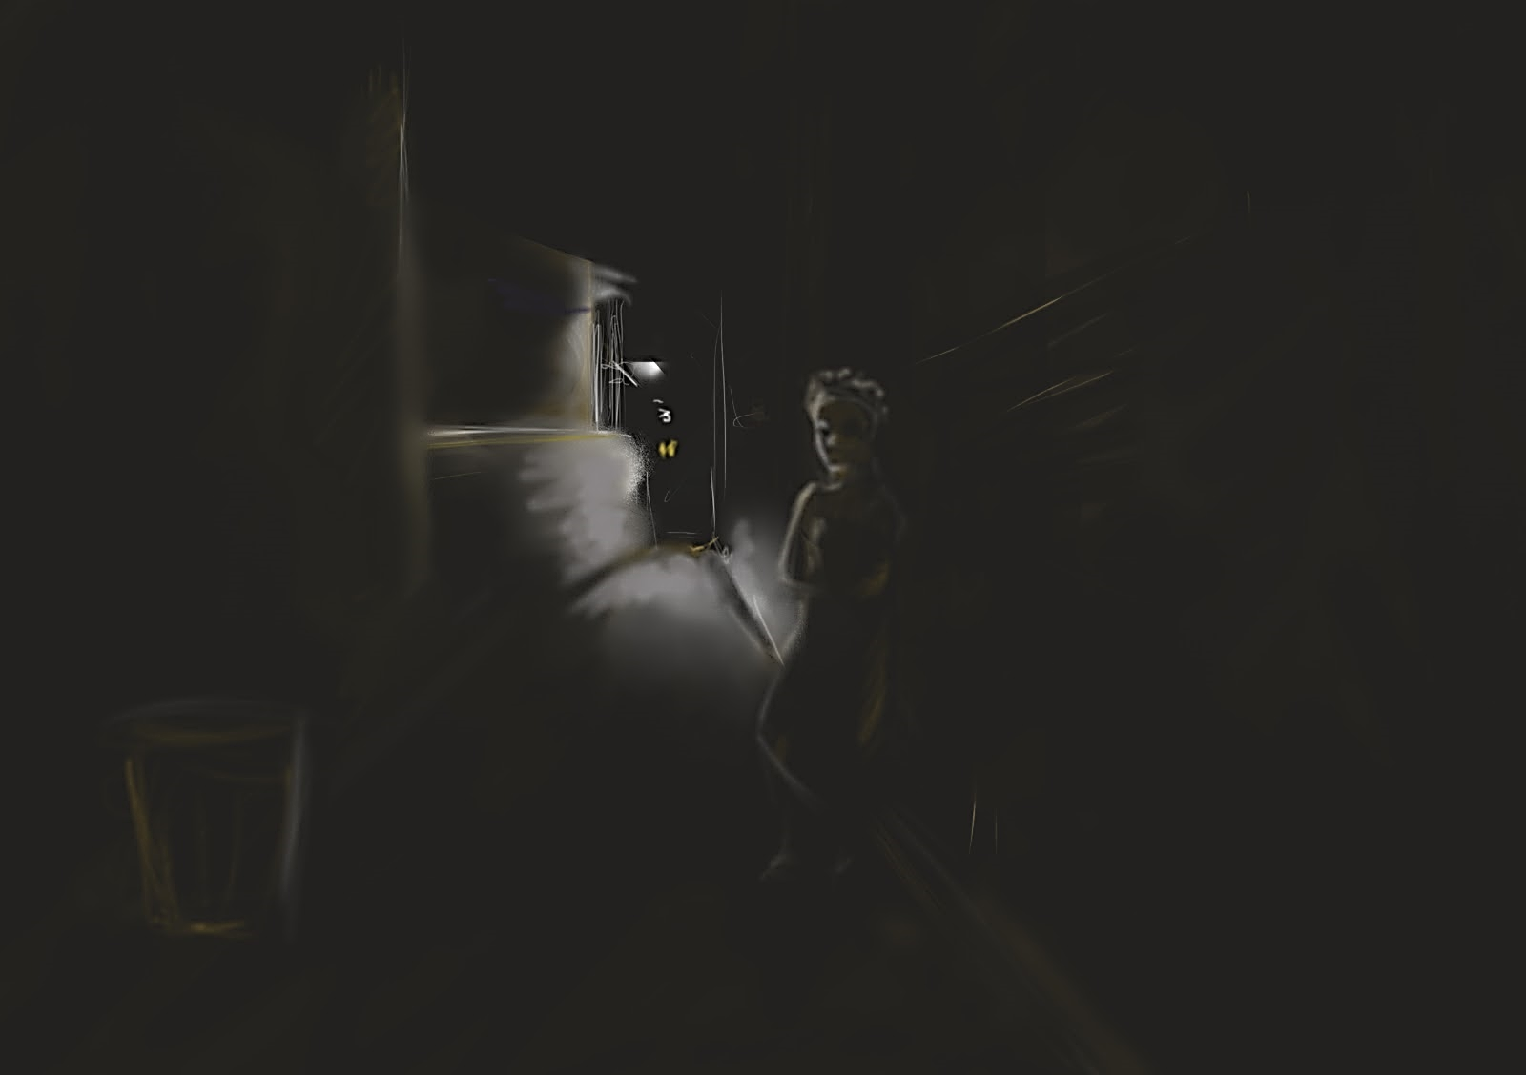
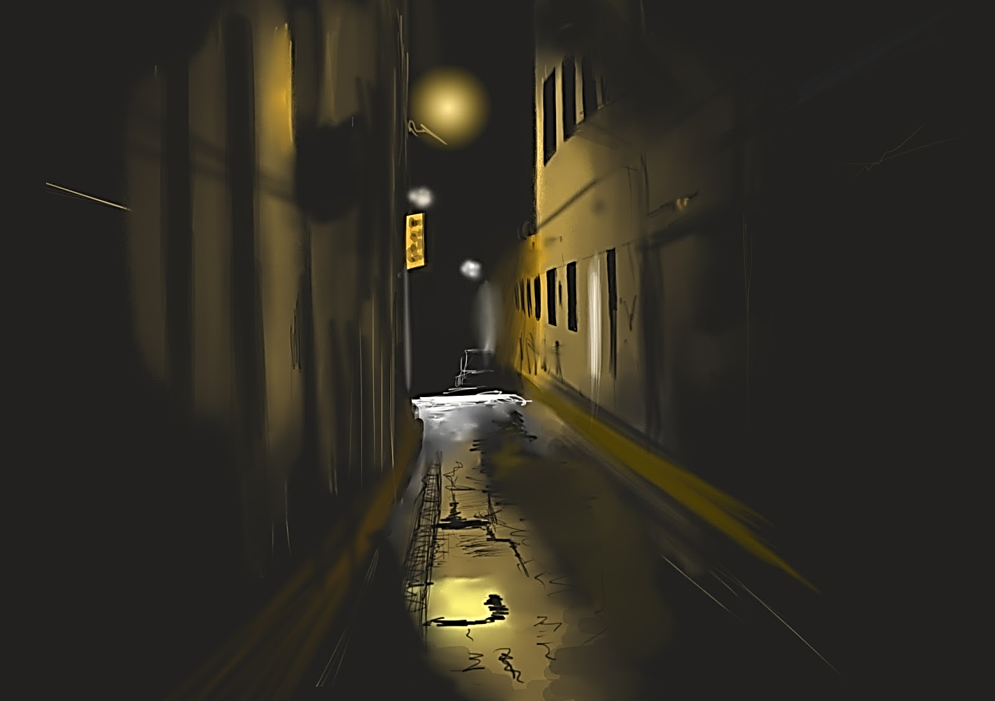
First Scenario
15 second scenario
Themes: sexual assault by men
Location: sketchy alleyway
scary man eyeing you up and down
Goal: portraying the fear of situation
Do-able to film regarding Covid-19
One male actor
Equipment and props
Sound design

Slide 22
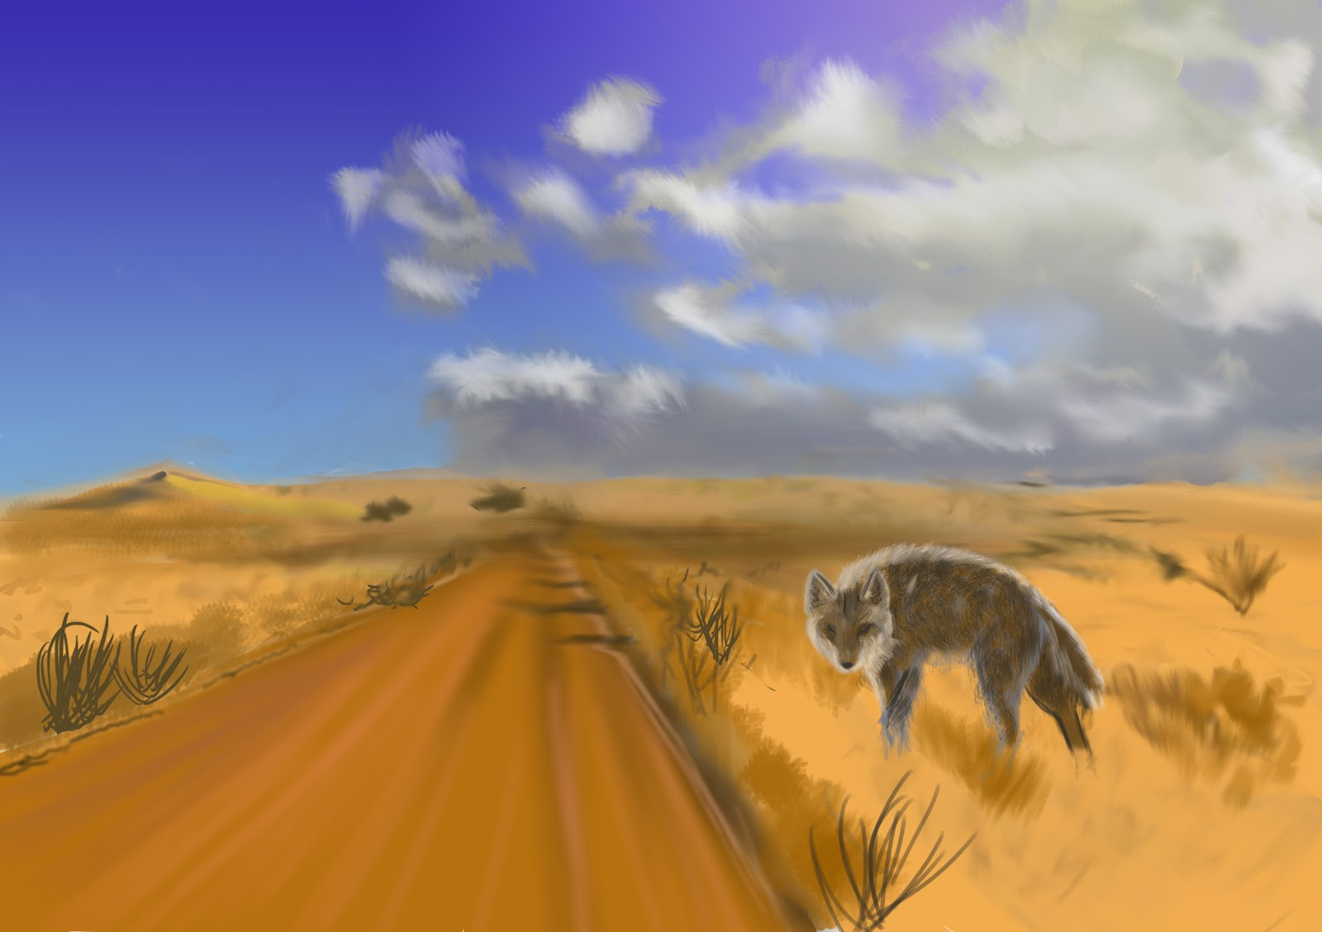
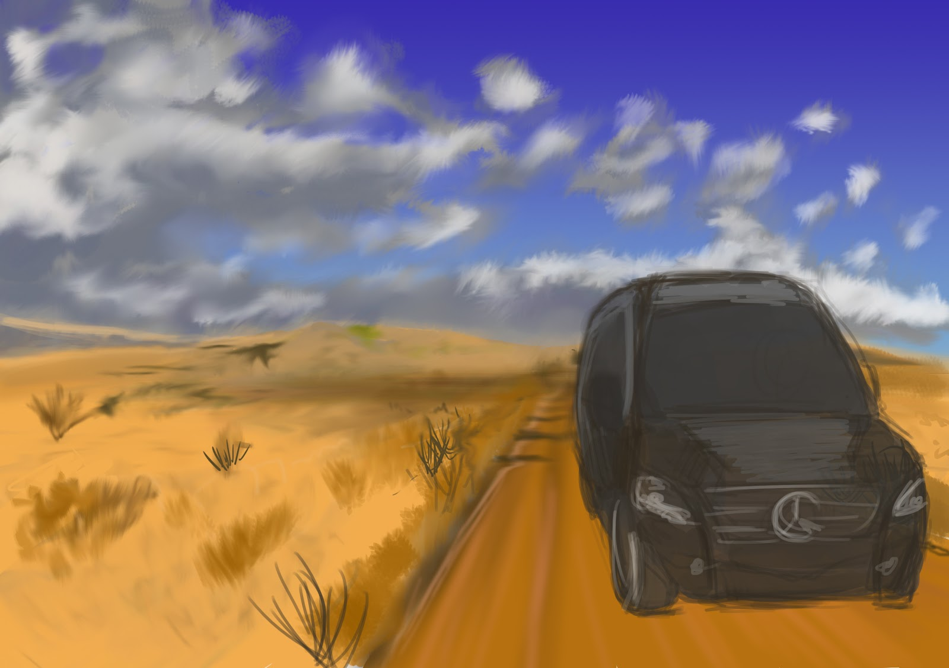
Second Scenario
15 second scenario
Theme: kidnapping
Location: in the desert
walking through a side-alley, getting kidnapped in a car
Goal: creating a stressful situation
Possible to film regarding Covid-19 with placement of rock (crew)
One male actor
Equipment, Car, Coyote optional
Sound Design

Slide 23
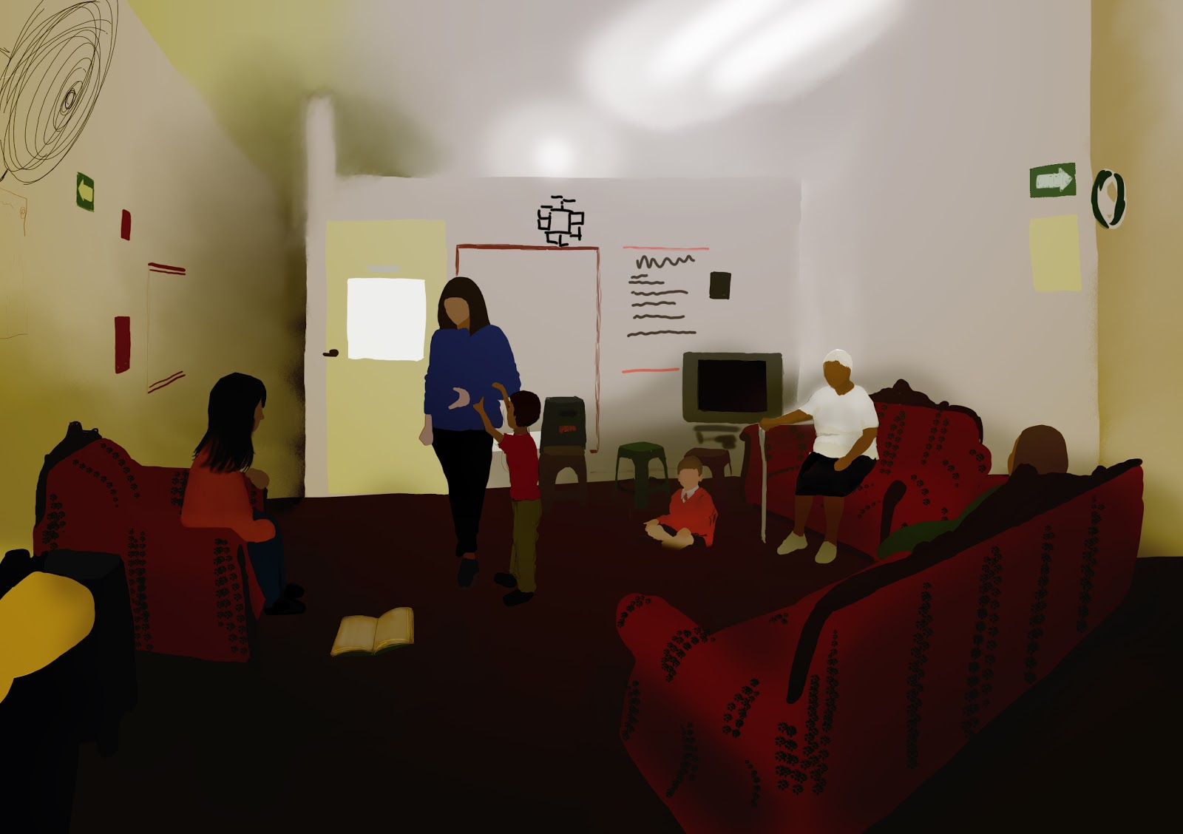
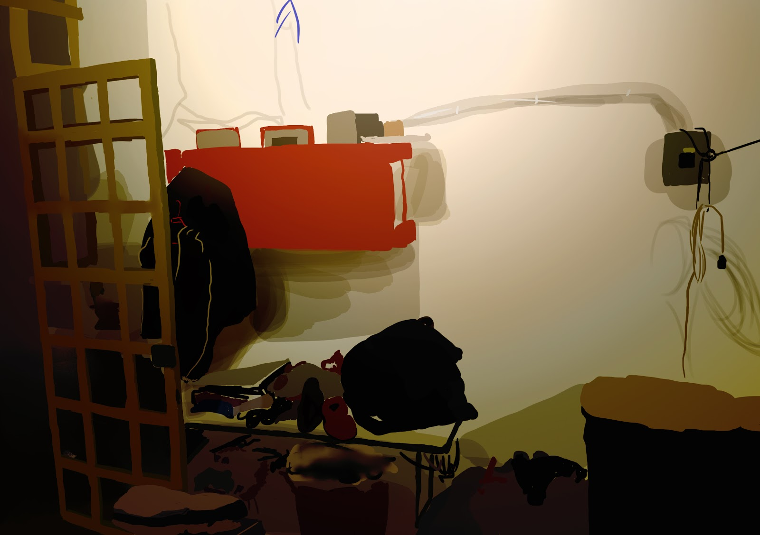
Third Scenario
15 second scenario
Themes: everyday life
Location: Museo de la Mujer Migrante
Children running by
Goal: portraying living conditions
hard to film regarding Covid-19
Three woman, two children
Equipment and props
Sound design

Slide 24
Risk assessment
Recordings becoming
corrupt
Not having back-up batteries for camera
Actors getting sick before recording due Covid-19
Unfavorable weather conditions
Filming in private or unauthorised locations
LOW
LOW
MEDIUM
HIGH
LOW
LOW
LOW
Actors cancelling/not showing up before recording
Tripod and camera cancelling damage

Slide 25

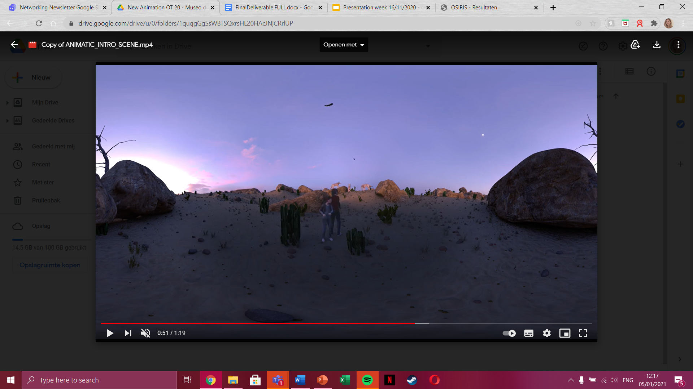
05
Conclusions & recommendations

Slide 26
Conclusions & Recommendations
360 VIDEO
360 SCENARIOS
RECOMMENDATIONS
VOLUMETRIC CAPTURING
EMPATHY

Slide 27
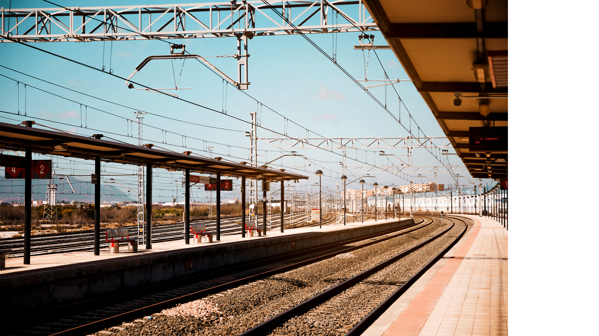
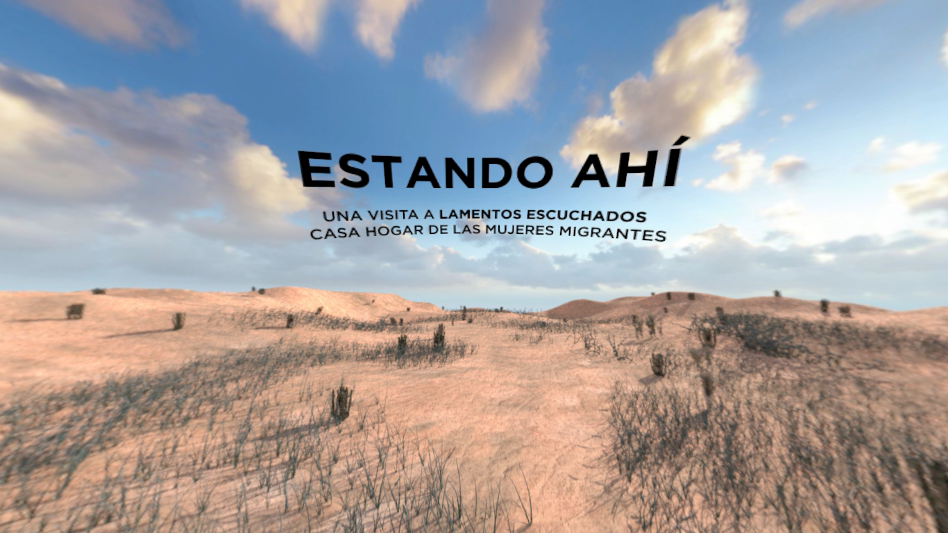
THANK YOU!
Does anyone have any questions?

